Slide 1




Presentation by
0044-BSCS-2020 - Umais Usmani
0083-BSCS-2020 - Muhammad Ibrahim
Supervisor
Mobile Applicsdso
Dr Muhammad Ilyas Fakhir

Slide 2

Table of Contents
Introduction
Problem
Need and Solution
Scope
Market
Technologies tools and Approaches
Features
Future Work
Conclusion

Slide 3
Brief Introduction
Gamified fitness app that tracks and recommends dietary goals/ needs as well as daily workouts.
Essentially gamifies a persons fitness journey
Makes fitness fun and easier

Slide 4

The Problem
Staying fit : A mountain of a task
Too many sources and clutter
Lack of engagement and short term incentives
Difficulty in tracking

Slide 5
Need and Solution
Simplification
Accessibility
Engagement : Incentives, Presentation
Gamification and incentives are psychologically effective.
Cases: Duolingo and Habitica.
Fitness Quest offers a unique solution combining fitness with game-like rewards and incentives.

Slide 6
Scope
Target audience includes everyone, from younger teens to adults.
Beginner Friendly
Customizable options for different fitness levels and preferences (e.g., dumbbells or no dumbbells).

Slide 7
Market
No direct competitors in the fitness niche.
Comparison with Duolingo and Habitica in terms of gamification and incentives.
Unique approach to a very common problem

Slide 8
Technologies tools and Approaches
Technologies used
JSON for exercise presets.
Flutter
Firestore
Photoshop
Firebase Auth
Edamam's Recipe API with over 2.3 million recipes.
Original app design and illustrations.

Slide 9

Primary Features
User Auth and Profile Creation
Avatar Customizer
Calculation of Score
Food Logging (Edamam API)
Workout Logging and Fetching
Caloric Recommendations
Fitopian Story
Shop and Customizables

Slide 10
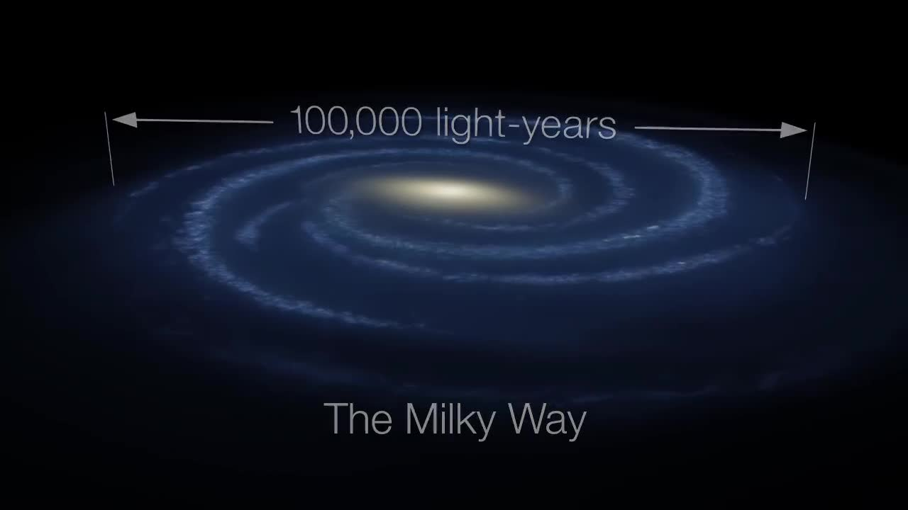
User Authentication
Using Firebase Authentication.
Register / Login
Authenticating by Email and password
Email verification

Slide 11
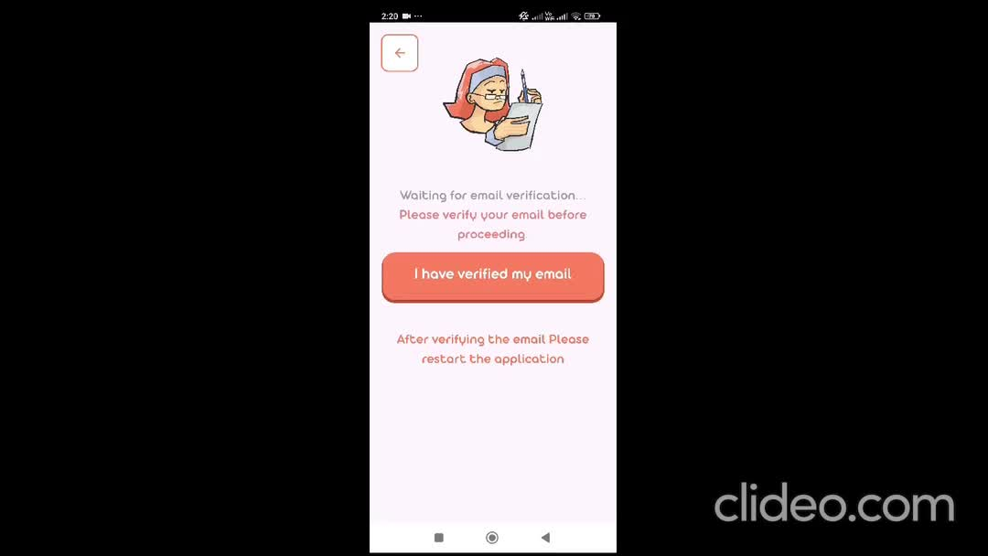
Email Verification
Verifying the person’s Email

Slide 12
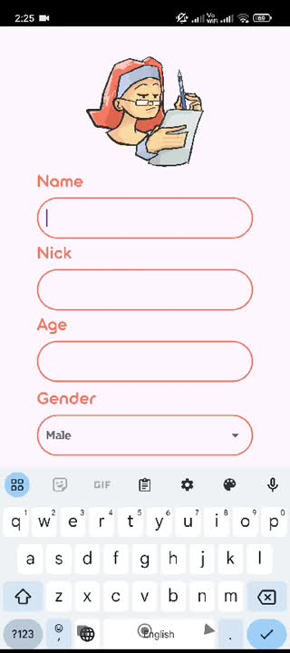
Profile Creation
Multi step Form (i.e User Information)
Basic Info (Name, age...)
Weight, Height, Gender (For caloric calculation)
Goals, Difficulty etc (For workout recommendation)

Slide 13
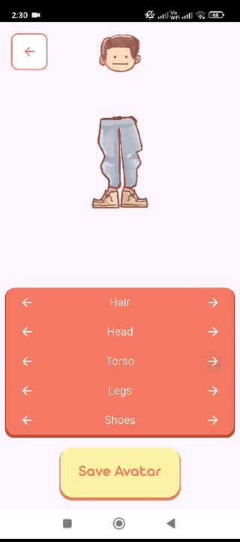
Avatar Customizer
Users Personal Avatar
Initially Default Assets
Purchase Assets from shop

Slide 14
Caloric Recommendations
The parameters
gender
age
height / weight
activity level
Calculates BMR
Adjusts for Activity Levels
Goal Adjustment
Caloric Needs

Slide 15
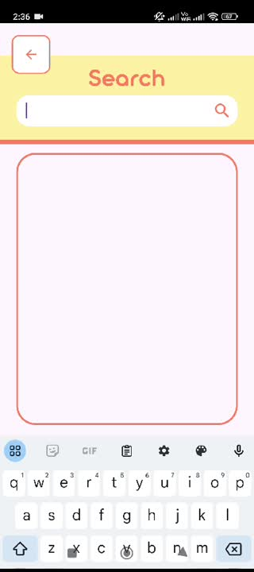
Edamam Food API
Food Search
Handling the JSON respone
Food will be displayed with Calories and Weight (grams)

Slide 16
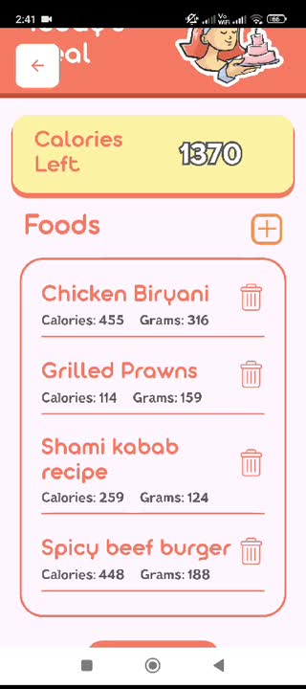
Food Logging
Display daily Caloric needs and adjust them
Add food from API
Log in the calories and weight as per one serving size
Today’s meals will be displayed

Slide 17
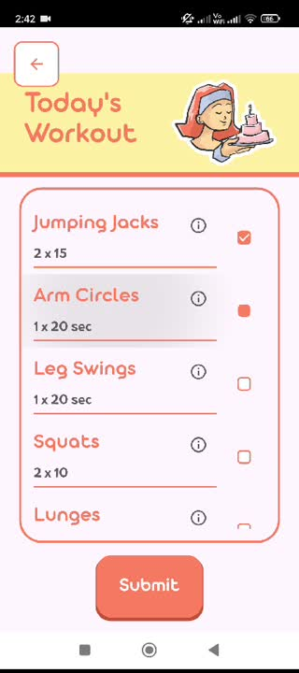
Workout Logging/ Fetching
Workout Recommendation
Fetching workouts from JSON
Check boxes, workout info, fitni points
Submit workouts

Slide 18
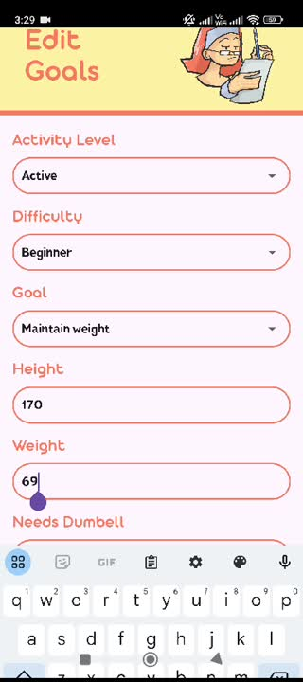
Edit/ View Goals
View your current goals
Edit and effects in real time

Slide 19
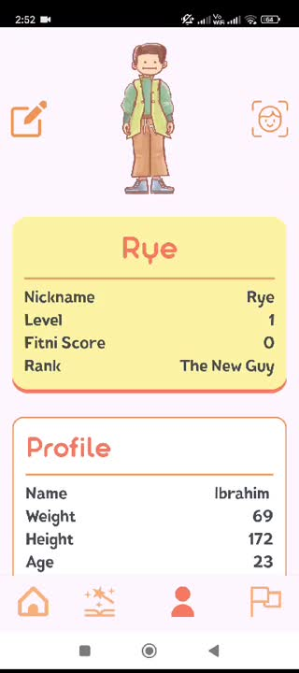
Edit/ View Profile
User Avatar
Basic info
General account stats
Real time edits

Slide 20
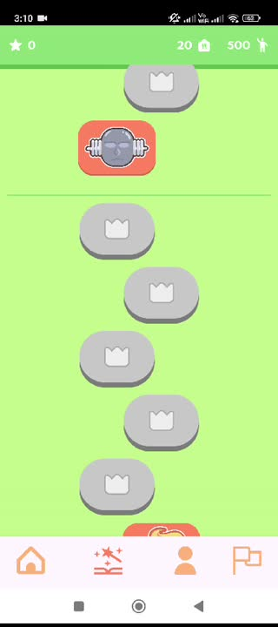
Fitopian Story
The Currencies and Points
Fitopians
Protein Bars
Fitni Score/ Quest Score
Completed / Uncompleted milestones
Boss Levels
Fitni Score
Rewards (fitopians, protein bars)

Slide 21
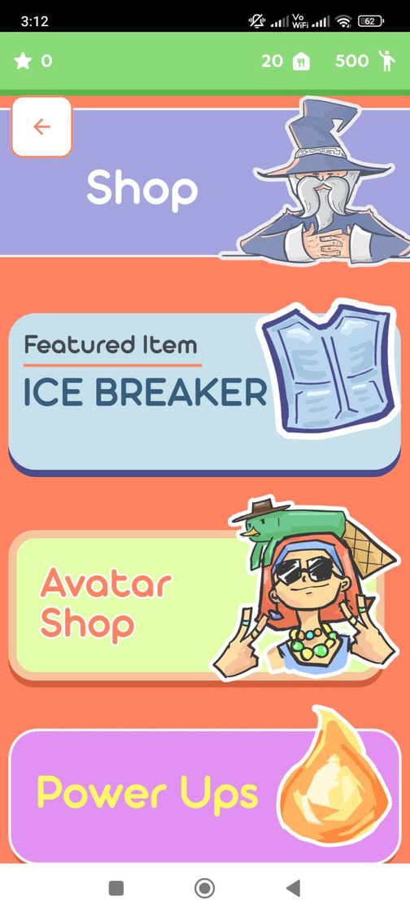
Shop
Avatar shop
Featured items
Power ups

Slide 22
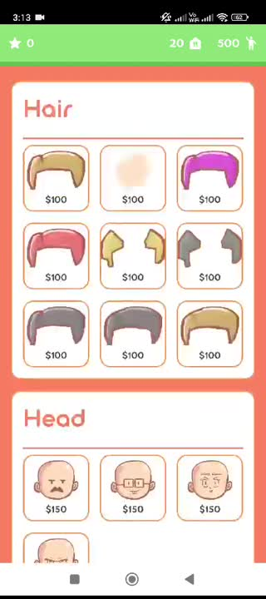
Avatar Shop
Customizable Items for avatar
Purchase item (owned item)

Slide 23

Featured item
Featured item of the month
Buffs and thematic additions

Slide 24

Power ups
Fitopian Multiplier
Protein bar Multiplier
Additonal Powerups
Quest Score Multiplier
Streak Freeze

Slide 25
Quest Score Calculation
Delete the Universe function
Day increment
Resetting daily logs
Calculating workout score
Calculating diet score

Slide 26
Future Work
Character pop-ups and boss fight animations.
Running and walking API support.
Dietary classification for allergies.
Ability to add personal recipes.
More story chapters
And many more...

Slide 27
Conclusion
The Impact
Franchise and potential for growth
Future Plans and more generalization

